Slide 1
Use cases and Flow of events
A use case describes what a system (or a subsystem, class, or interface) does but it does not specify how it does it.
When you model, it's important that you keep clear the separation of concerns between this outside and inside view.

Slide 2
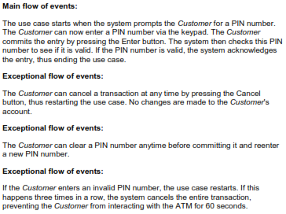
Case 1

Slide 3
Use case & Scenario
Each sequence is called a scenario.
A scenario is a specific sequence of actions that illustrates behavior.
Scenarios are to use cases as instances are to classes, meaning that a scenario is basically one instance of a use case.
For each use case, you'll find primary scenarios (which define essential sequences) and secondary scenarios (which define alternative sequences).

Slide 4
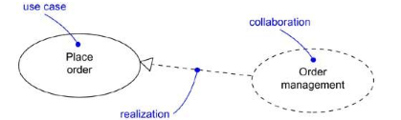
Use Cases and Collaboration
The society of elements including both static and dynamic structure is modelled as collaboration.

Slide 5
Organizing Use cases
You can organize use cases by grouping them in packages in the same manner in which you can organize classes
You can also organize use cases by specifying generalization, include, and extend relationships among them.
You apply these relationships in order to factor common behavior (by pulling such behavior from other use cases that it includes) and in order to factor variants (by pushing such behavior into other use cases that extend it).

Slide 6
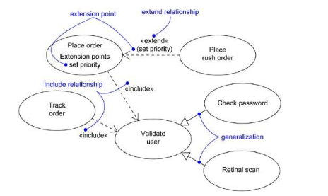

Slide 7
Dependencies
Include
Extend
A standard case linked to an mandatory use case.
tight coupling
Standard use case can NOT execute without the include case.
Represented by stereotype <<include>>
Ex: (one cannot live without the other. The usecase must include another use case)
When you create
an order you always must verify name etc.
linking an optional use case to a standard use case.
loose coupling
Standard use case can execute without the extend case.
Represented by stereotype <<extend>>
Ex: (one can live without the other only some instances the use case will extend to another use case to do some stuff. )
you can create an order but if the order is for a new customer you possible have to do additional check which you do not have to do for existing customers.

Slide 8
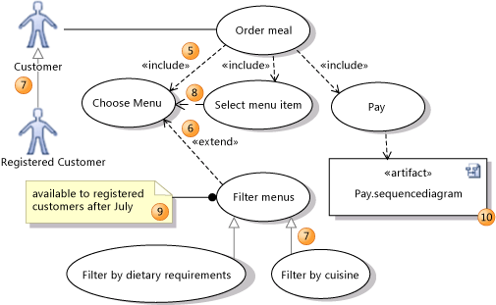

Slide 9

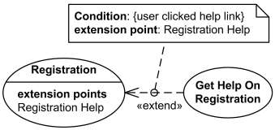
Extend relationship is shown as a dashed line with an open arrowhead directed from the extending use case to the extended (base) use case.
Registration use case is complete and meaningful on its own. It could be extended with optional Get Help On Registration use case.
The condition of the extend relationship as well as the references to the extension points are optionally shown in a comment note attached to the corresponding extend relationship.

Slide 10
Common Modelling Techniques
1. Modelling the behavior of an element
  A. identify actors
  B. Organize actors
  C. Interaction of actors
  D. Consider exception ways how actor interacts with element
  E. Organize Usecase include and exclude

Slide 11
Use case Diagrams
Contents of Use case diagram
  Use Case
  Actors
  Dependency, generalization, association relationship.

Slide 12
Common uses(Common Modelling techniques)
  To model the context of a system
    Identify Actors.
    Organize actors. (Generalization)
    Provide Stereotype if necessary
    Specify paths of communication fro actor to usecase.
  To model the requirements of a system.
    Establish context of system by identifying actors that surround it
    For each actor, consider the behavior
    Name common behaviors as usecase
    Factor common behaviors in to new usecase that are used by others, Factor variant behaviors in to new usecase that extends more main line flows.
    Model usecases, actors and their relationships
    Adorn with notes.

Slide 13
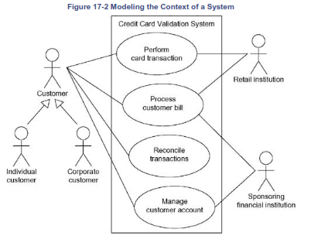

Slide 14
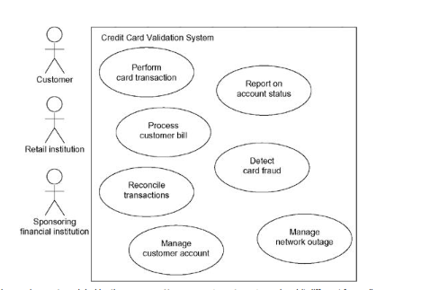

Slide 15
Forward and Reverse Engineering
Forward engineering is the process of transforming a model into code through a mapping to an implementation language.
Use cases describe how an element behaves, not how that behavior is implemented, so it cannot be directly forward or reverse engineered.
Other diagrams, including class, component, and statechart diagrams, are clear candidates for forward and reverse engineering because each has an analog in the executable system.

Slide 16
Forward Engineering
A use case diagram can be forward engineered to form tests for the element to which it applies. Each use case in a use case diagram specifies a flow of events (and variants of those flows), and these flows specify how the element is expected to behave.
A well-structured use case will even specify pre- and post conditions that can be used to define a test's initial state and its success criteria.
For each use case in a use case diagram, you can create a test case that you can run every time you release a new version of that element, thereby confirming that it works as required before other elements rely on it.

Slide 17
Forward Engineering
To forward engineer a use case diagram
  For each use case, identify flow of events and its exceptional flow of events.
  Depending on how deeply you choose to test, generate a test script for each flow, using the flow's preconditions as the test's initial state and its postconditions as its success criteria.
  As necessary, generate test scaffolding to represent each actor that interacts with the use case. Actors that push information to the element or are acted on by the element may either be simulated or substituted by its real-world equivalent.
  Use tools to run these tests each time you release the element to which the use case diagram applies.

Slide 18
Reverse Engineering
Reverse engineering is the process of transforming code into a model through a mapping from a specific implementation language.
Automatically reverse engineering a use case diagram is pretty much beyond the state of the art, simply because there is a loss of information when moving from a specification of how an element behaves to how it is implemented

Slide 19
Identify each actor that interacts with the system.
For each actor, consider the manner in which that actor interacts with the system, changes the state of the system or its environment, or responds to some event.
Trace the flow of events in the executable system relative to each actor. Start with primary flows and only later consider alternative paths.
Cluster related flows by declaring a corresponding use case. Consider modeling variants using extend relationships, and consider modeling common flows by applying include relationships.
Render these actors and use cases in a use case diagram, and establish their relationships.

